Slide 1
Case Study 1
Group 7: Jacob Bissonette, Austin Franklin, Yuriy Kamenivskyy,
Garrett McMerriman, Bill Pham

Slide 2

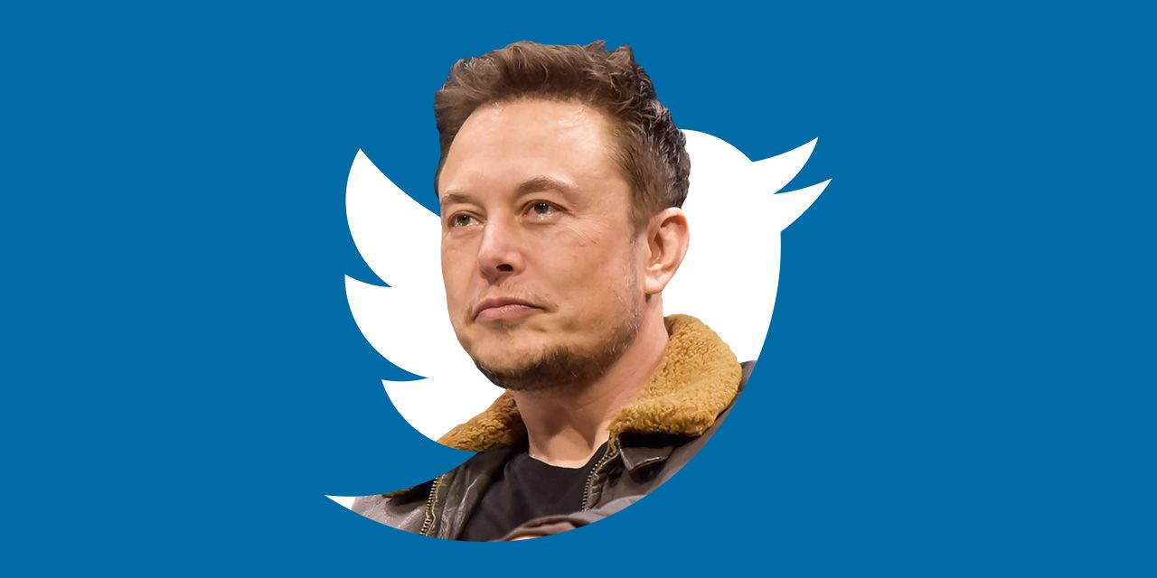
Data Collection
Nutrition
Elon Musk
Arcane
Notes:
Mention how many tweets we had for each
For the first two problems we gathered data on the topic of nutrition. We searched for words that appear most frequently alongside nutrition in tweets, the most retweeted tweets on the topic, as well as the most frequent mentions and hashtags from tweets about nutrition.
Then for problem three, the famous person of our choice was Elon Musk. With Musk’s Twitter account we collected users that are his account’s followers, friends, and those that are in both the followers and friends lists.
And lastly, we looked at the Netflix show Arcane. The search query looked for tweets with a negative attitude to see if viewers liked the show or not.

Slide 3


Motivation 1
Notes:
Yuriy
For the first two problems
We wanted to find what do people that tweet about nutrition care about the most and what trends coincide with the trend of nutrition.

Slide 4
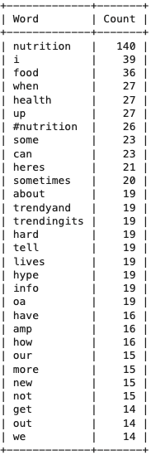
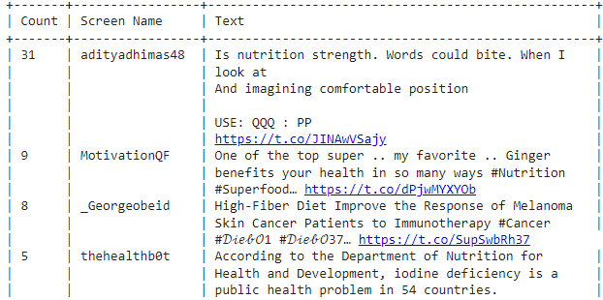
Problem 2: Top Words and Retweets
Notes:
Collected 300 tweets
Top 30 words when looking up “nutrition”
Things like “I”, “food”, “health”
Recurring themes

Slide 5
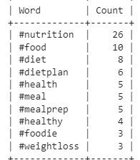
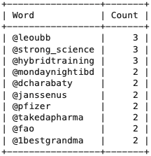
Problem 2: Top Hashtags and Mentions
Notes:
Austin
More about nutrition
Eating
Diet Plan
Health

Slide 6
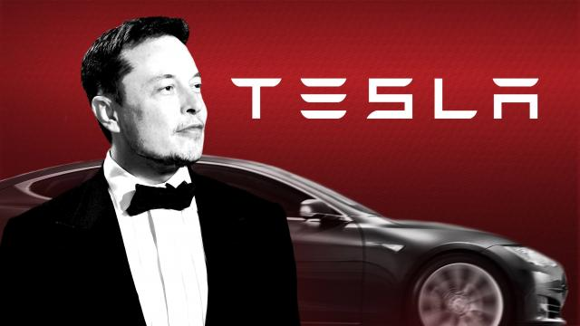

Motivation 2
Notes:
Yuriy
For our popular Twitter user, we decided to choose Elon Musk who is an entrepreneur who is a very active Twitter user, who has a very large following. We decided to pair him up with Lex Fridman, who is a very famous computer scientist who recently had Elon on his podcast.

Slide 7
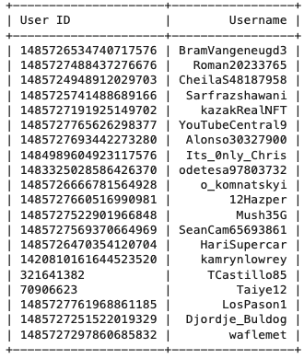
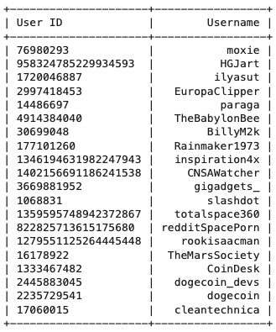
Problem 3: Musk’s Followers and Friends
Followers VS. Friends
Notes:
Takeaways:
Some longtime Twitter users just started following Musk
Some Friends are also longtime Twitter users -> the fact that some of their IDs are very short. Suggests that some of his latest followers, are old time twitter users, that only recently decided to follow Musk on twitter.

Slide 8
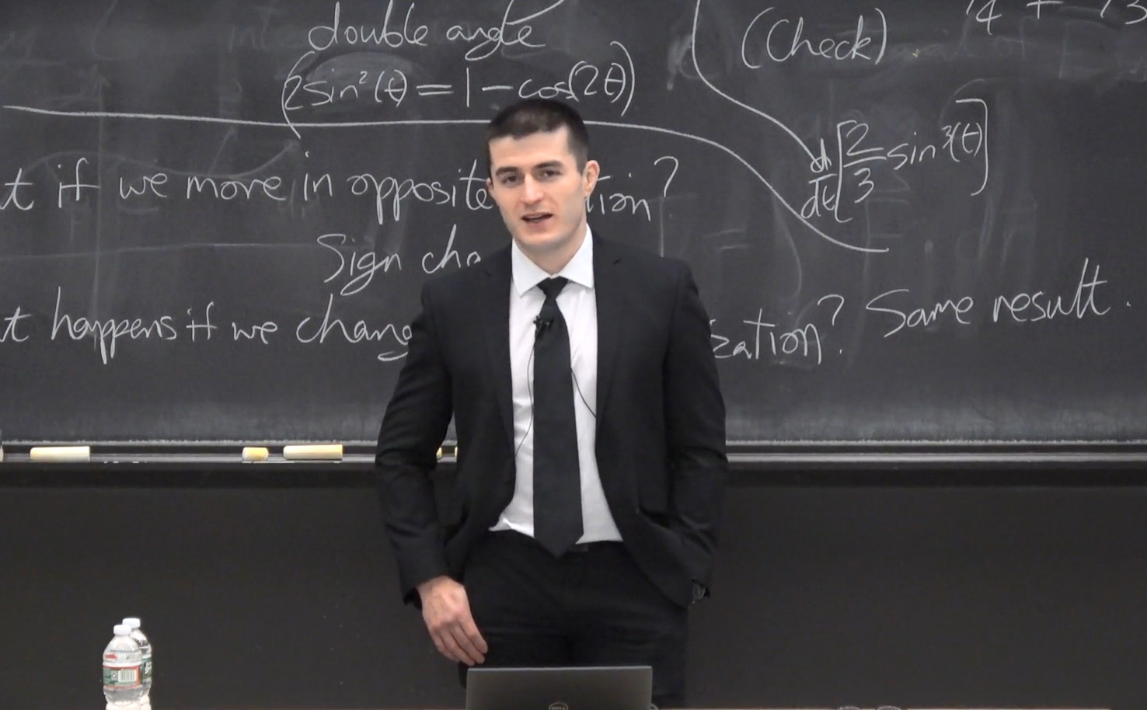
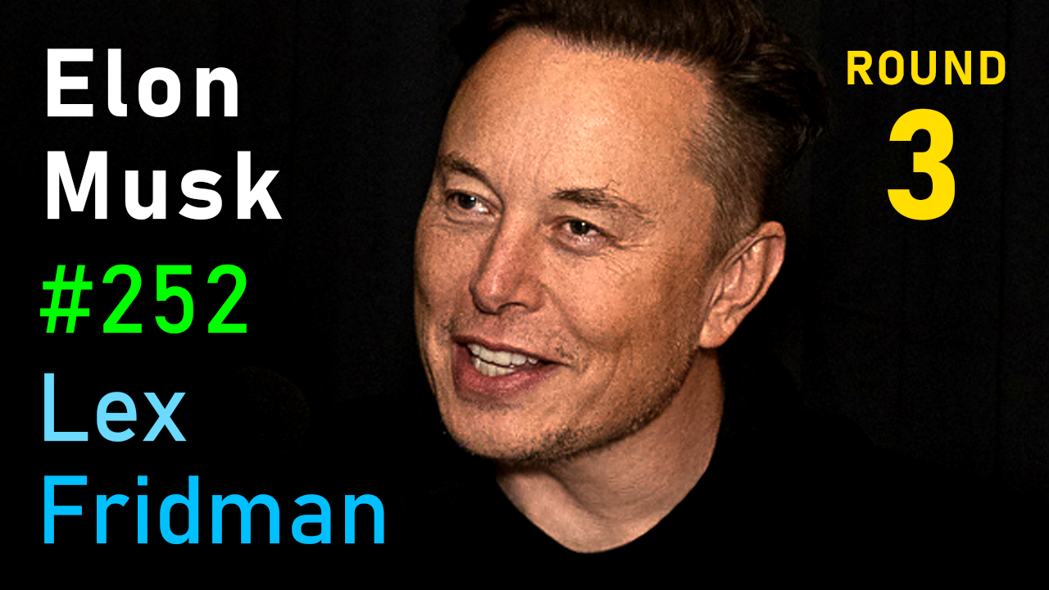
Problem 3.1: Common Friends
Notes:
Takeaways:
Looked for mutual friends of him and Lex Fridman
Both friends with twitter users, fermatslibrary, and engineers_feed
Was tough to gather accounts that are both friends and followers into a table
as approx. 71 million followers, only 107 are friends

Slide 9
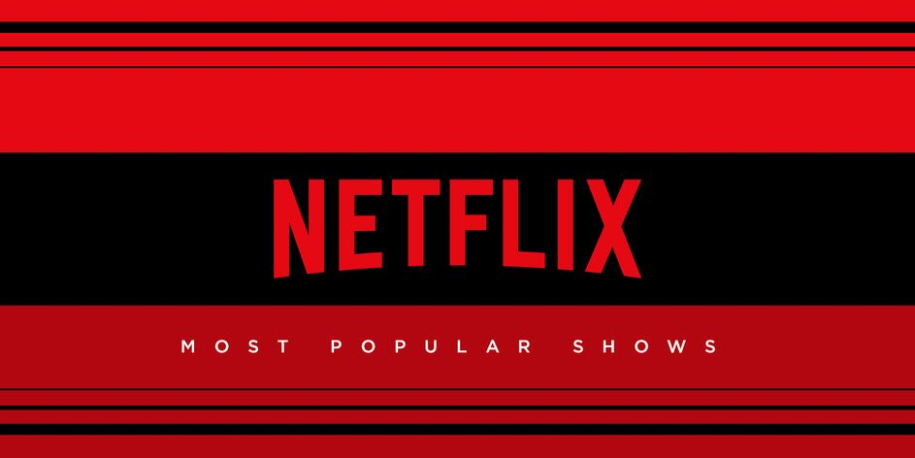

Motivation 3
Notes:
For our problem 4 we decided to look into a popular Netflix show called Arcane which is based on a popular game called League of Legends. I recently watched the show and wanted to see if there were any negative tweets about the show to then further learn about the series and how it was welcomed by the community.

Slide 10
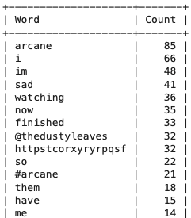
Problem 4: Top words
Query = "Arcane :("
Notes:
Query = "Arcane :("
Associated words
Popular tweets (retweet and likes)
Netflix and League of Legends followers

Slide 11
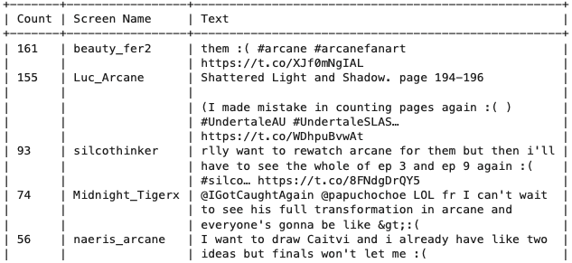
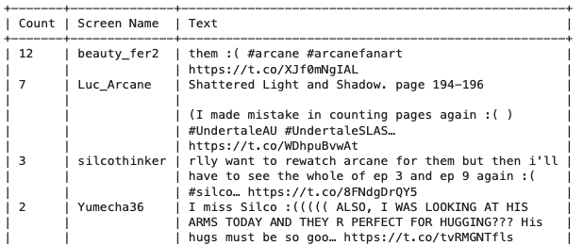
Problem 4: Top Tweets
Notes:
Thus we suggest that there is a melodramatic romantic storyline in season 2 as well

Slide 12
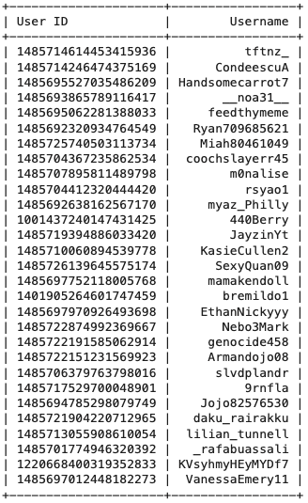
Problem 4: Target Audience Analysis
Notes:
Words: "Sad", "Vi"
Sad tweets (emotion)
Netflix and LoL

